Slide 1
DATA PROJECT
Pierre GILLY & Robin MAISANO

Slide 2
Sommaire
Subject Presentation
Task Repartition
Graph Generation
Algorithm
Simplification
Cluster / Greedy
Statistics
Which statistics
How do we get them
Results
Project Results
Conclusion

Slide 3

Subject Presentation
/10
ADEME called to promote new mobility solutions
Algorithm to find the best path to travel between cities
Statistics to predict how the algorithm will act
Subject presentation
Task repartition
Algorithm – Simplification
Algorithm – Cluster / Greedy
Statistics
- Which - How
Statistics - Results
Results
Graph Generation
Notes:
In order to reduce global warming and change mentalities

Slide 4
Task Repartition
/10
Graph creation – Pierre
Resolution algorithm – Robin
Statistics – Pierre
Subject presentation
Task repartition
Algorithm – Simplification
Algorithm – Cluster / Greedy
Statistics
- Which - How
Statistics - Results
Results
Graph Generation

Slide 5
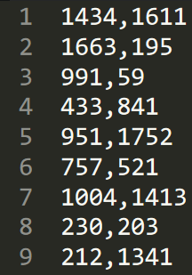
Storing the problem
/10
Cloud of point
Every point are connecting to each others
But no representation of the links
Stored in CSV file
Subject presentation
Task repartition
Algorithm – Simplification
Algorithm – Cluster / Greedy
Statistics
- Which - How
Statistics - Results
Results
Graph Generation

Slide 6
Generate Graphs
/10
MapGenerator.py
Simple code that put in the list X and Y randomized number
This create points with random coordinates
Write them in CSV file
Subject presentation
Task repartition
Algorithm – Simplification
Algorithm – Cluster / Greedy
Statistics
- Which - How
Statistics - Results
Results
Graph Generation

Slide 7
Algorithm Simplification
/10
VRP
Into : Multiple + TSP
Subject presentation
Task repartition
Algorithm – Simplification
Algorithm – Cluster / Greedy
Statistics
- Which - How
Statistics - Results
Results
Graph Generation

Slide 8
Algorithm Cluster / Greedy
/10
Subject presentation
Task repartition
Algorithm – Simplification
Algorithm – Cluster / Greedy
Statistics
- Which - How
Statistics - Results
Results
Graph Generation

Slide 9
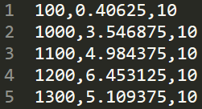
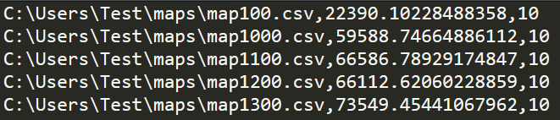
Statistics What we’ve done
/10
Statistics :
Mean, median, range, first quartile, third quartile, variance
Cloud of points
Regression line and its coefficients
Generated a lot of statistics with the scalability script
Stored the statistics in csv file :
stats.csv result.csv
Subject presentation
Task repartition
Algorithm – Simplification
Algorithm – Cluster / Greedy
Statistics
- Which - How
Statistics - Results
Results
Graph Generation

Slide 10
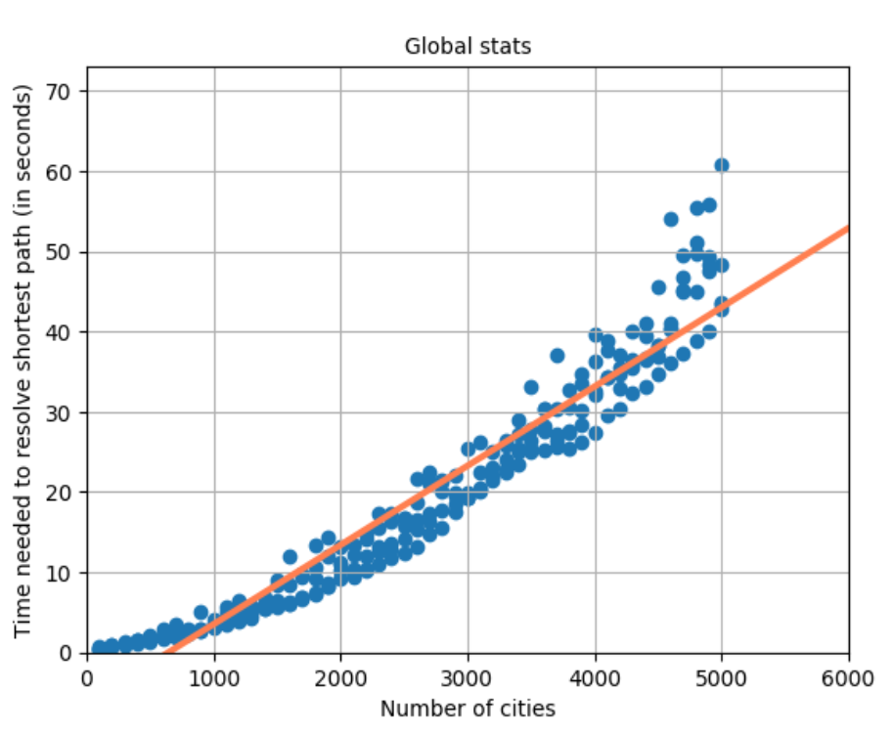
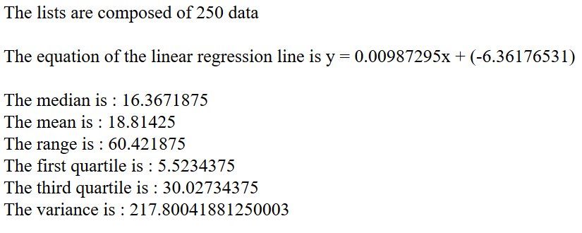
Statistics What does it looks like ?
/10
Subject presentation
Task repartition
Algorithm – Simplification
Algorithm – Cluster / Greedy
Statistics
- Which - How
Statistics - Results
Results
Graph Generation

Slide 11
Statistics Results
/10
The statistics are generated in a HTML report
More tucks equals more resolution time
Distances between cities has no impact on the resolution time.
More cities result in an increase of the resolution time
For the same graph, the time can vary a lot
Subject presentation
Task repartition
Algorithm – Simplification
Algorithm – Cluster / Greedy
Statistics
- Which - How
Statistics - Results
Results
Graph Generation
Notes:
- One part for the global statistics
One part for each number of trucks used (ex: 10, 20,30 ….)
For the same number of cities more trucks (clusters), more resolution time increases
Increasing the distance between cities has no impact or little impact on the resolution time.
With equal number of trucks, the more cities there are, the more the resolution time increases
The resolution time can vary enormously between several graphs of the same parameters (number of cities and distances).

Slide 12
Results
/10
Random graph generator
Resolution algorithm
VRP into TSP
Log stats and results
Constraint : k trucks
Statistics report generation
Descriptive statistics
Predictive statistics
Results interpretations
Subject presentation
Task repartition
Algorithm – Simplification
Algorithm – Cluster / Greedy
Statistics
- Which - How
Statistics - Results
Results
Graph Generation

Slide 13
Conclusion
/10
Subject presentation
Task repartition
Algorithm – Simplification
Algorithm – Cluster / Greedy
Statistics
- Which - How
Statistics - Results
Results
Graph Generation

Slide 14
/10
Thank you for your attention, if you have any questions, feel free to ask
Subject presentation
Task repartition
Algorithm – Simplification
Algorithm – Cluster / Greedy
Statistics
- Which - How
Statistics - Results
Results
Graph Generation

